Slide 1


SAP BTP Training
Cloud Foundry Training

Slide 2

DISCLAIMER
The training content and delivery of this presentation is confidential, and cannot be recorded, or copied and distributed to any third party, without the written consent of Anubhav Trainings

Slide 3

LEARNING OBJECTIVES
SAP BTP CAPM Development
Fiori Elements – Introduction
Tools for Fiori Development in BAS
Fiori Freestyle v/s Fiori Elements
Create Fiori App in CAP App
SAP BTP CAPM Development
Configuring 3rd Level Drill Down
Working with page map in BAS
Understanding fiori draft
Auto generate IDs
Composition concept
Value Help configuration
SAP HANA Cloud Introduction
Create SAP HANA Backing service in BTP

Slide 4



















Slide 5
Generic Handlers
The CAPM Framework generates most of the code for CURDQ operations on the entity, it also does these operations in synchronous manner. At time, we want to
Take full control on CURDQ
I want to add my custom validations before data is updated
We want to change data with enrichment
Read data we want to add extra information
When? (on,before,after) – before
Who? - ENTITY - Employee
Operation? – CREATE, UPDATE
What? – Validate if input Sal < 1mn
DB
User/Developer
Service
CAPM Framework
before
on
after
www.anubhavtrainings.com

Slide 6
ACID properties of DB
A – Atomicity
C - Consistency
I - Isolation
D - Durability
OData V4 which is a latest version of OData version 2. SAP released a backward compatible module which converge the V4 capm services to OData v2.
The module is named as @sap/cds-odata-v2-adapter-proxy
www.anubhavtrainings.com

Slide 7
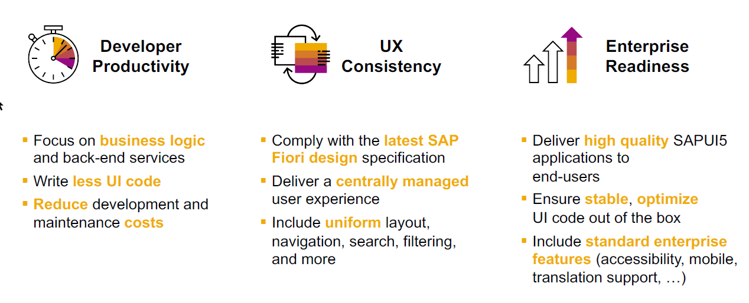
SAP Fiori elements boosts SAP Fiori development efficiency
www.anubhavtrainings.com

Slide 8
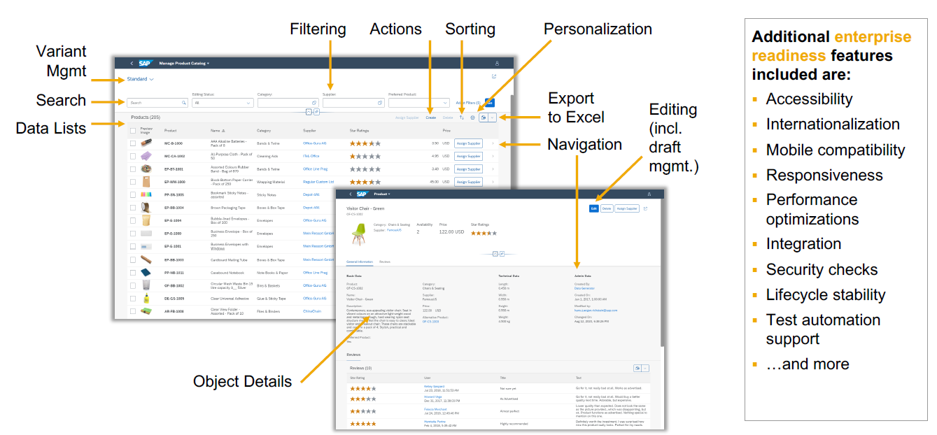
SAP Fiori elements provides enterprise-ready apps out of the box
www.anubhavtrainings.com

Slide 9
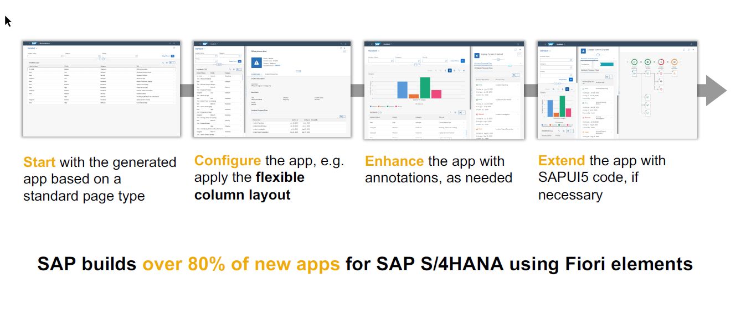
SAP Fiori elements application architecture provides flexibility
www.anubhavtrainings.com

Slide 10

SAP Fiori elements prioritizes efficiency over flexibility
www.anubhavtrainings.com

Slide 11
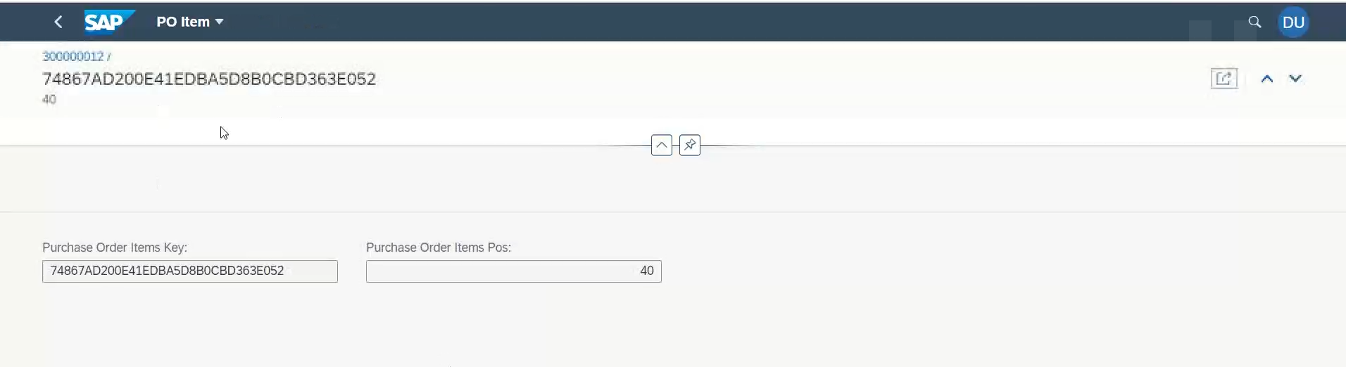
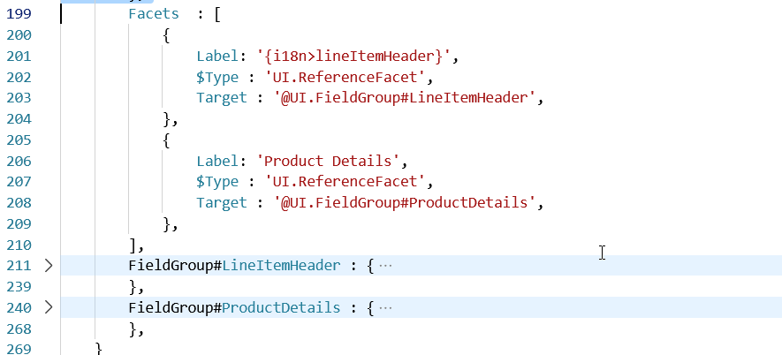
Configure Level 3 Drill down
www.anubhavtrainings.com

Slide 12
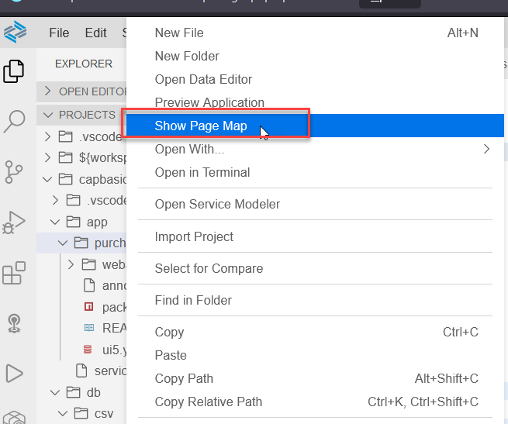
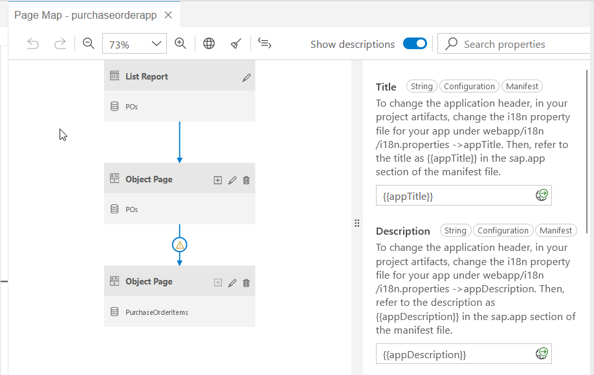
Working with Page Map in BAS
www.anubhavtrainings.com

Slide 13
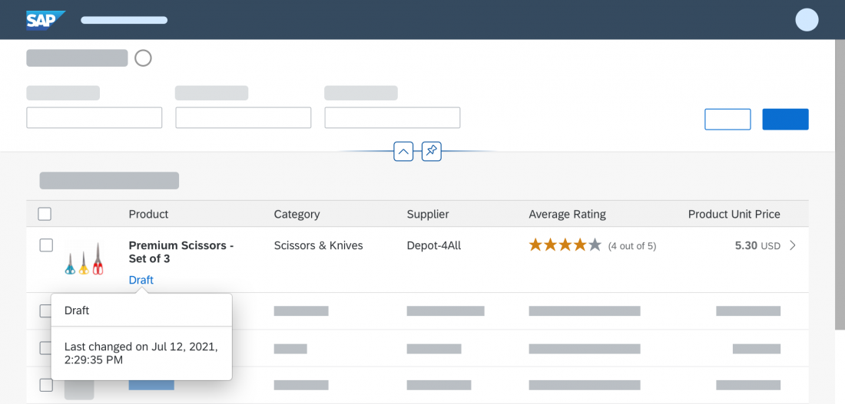
What is draft?
A draft is a temporary version of a business entity that has not yet been explicitly saved as an active version.
Drafts are used:
To keep unsaved changes if an editing activity is interrupted, allowing users to resume editing later.
To prevent data loss if an app terminates unexpectedly.
As a locking mechanism to prevent multiple users from editing the same object at the same time, and to make users aware when there are unsaved changes by another user.
www.anubhavtrainings.com

Slide 14
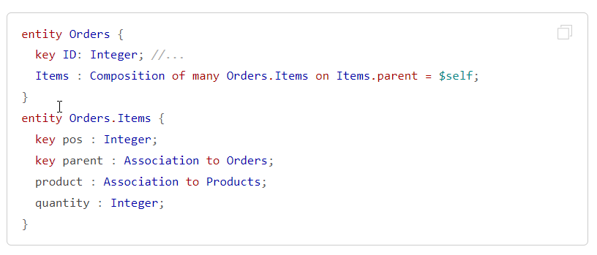

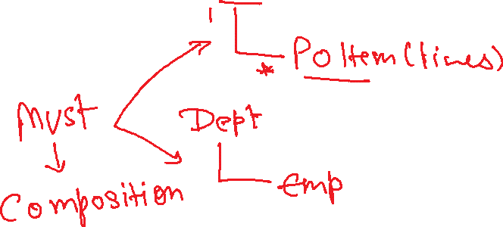


Compositions in CAPM
Compositions constitute document structures through ‘contained-in’ relationships. They frequently show up in to-many header-child scenarios.
Essentially, Compositions are the same as associations, just with the additional information that this association represents a contained-in relationship so the same syntax and rules apply in their base form.
www.anubhavtrainings.com

Slide 15
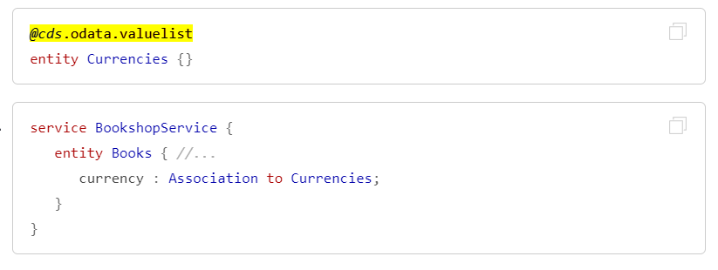
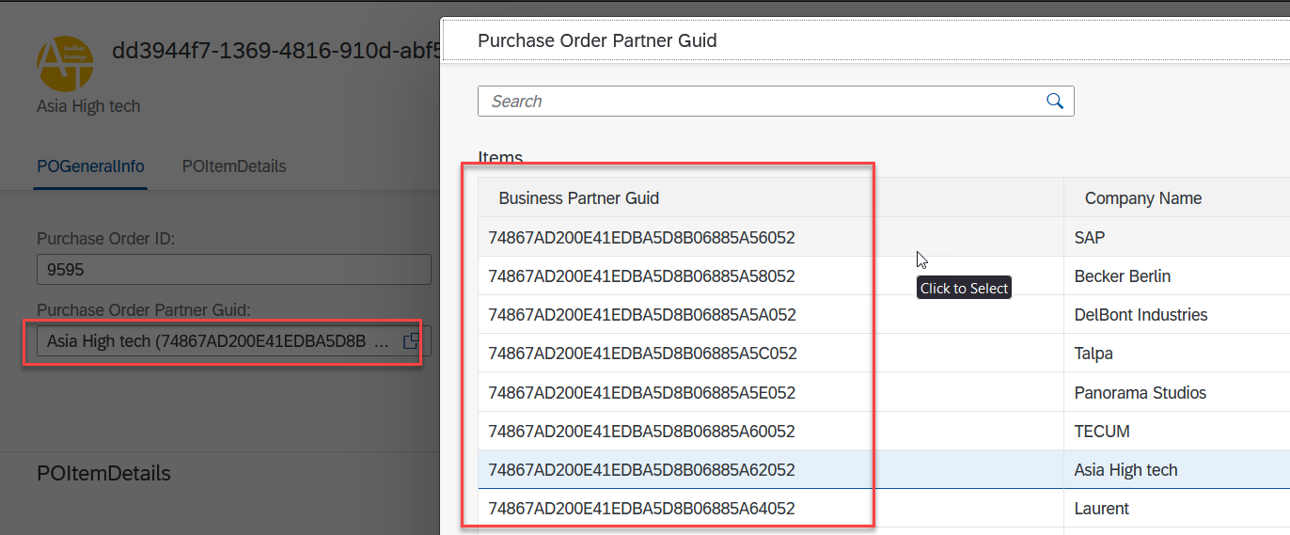
Value Help Integrations in CAPM
Simply add the @cds.odata.valuelist annotation to an entity, and all managed associations targeting this entity will automatically receive Value Lists in SAP Fiori clients. For example:
www.anubhavtrainings.com

Slide 16
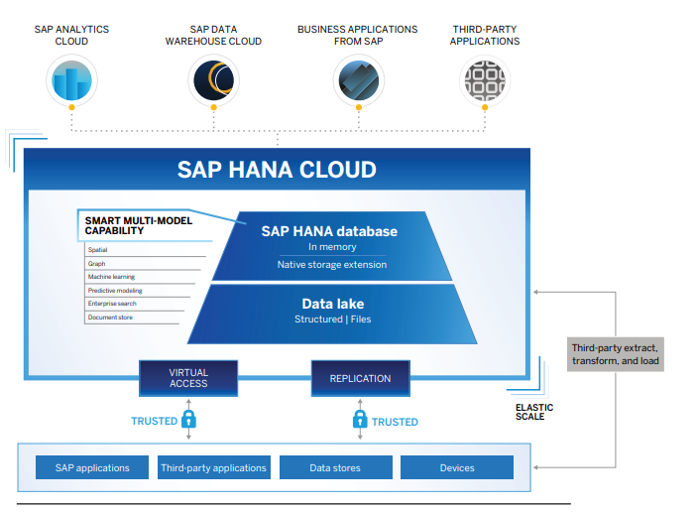
What is SAP HANA Cloud in BTP?
SAP HANA Cloud is a single database as a service (DBaaS) foundation for modern applications and analytics across all enterprise data.
SAP HANA Cloud delivers scalability, speed, and flexibility with elastic pricing to adapt to your changing needs and in-memory processing to significantly reduce your response
With SAP HANA Cloud, you can store and process multiple types of business data – including spatial, graph, hierarchy, document, and SQL.
It also helps you perform advanced analytics on live transactions without tuning your machine learning models. And you can use advanced analytics to build custom applications with high data volumes.
www.anubhavtrainings.com

Slide 17
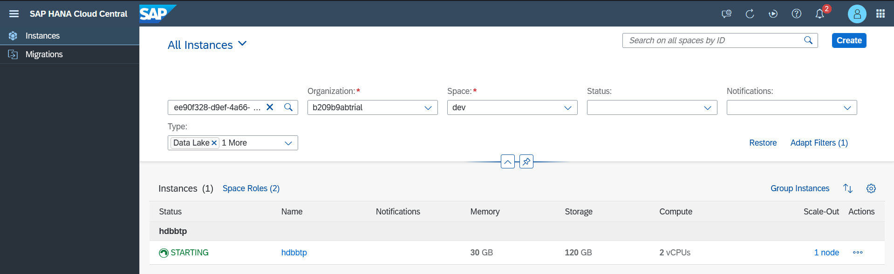
Setup SAP HANA Cloud DB free tier in BTP
www.anubhavtrainings.com

Slide 18
Connect, Build and Deploy to SAP HANA Cloud
Checked the version of CDS (which must be > 2.0) cds –v
Started a HANA Cloud instance in SAP BTP
We added SAP HANA configuration so our app can talk to HANA cds add hana
Added hana deployment config to tell CAPM that our format for deployment is hdbtable under cds section
"hana": {
"deploy-format": "hdbtable"
},
5. We add hana db module npm add hdb
6. Build hana specific artefacts cds build –production
7. Must login to CF cf login
8. Finally we deploy to HANA to create physical DB Object cds deploy --to hana:mickey
9. Create a new mta.yaml instead of manifest.yml, cds add mta
10. We manually added our UI Module with require as srv-api
11. Inside the app folder we added package.json with @sap/approuter module
12. Added start script for package.json with approuter.js
13. Added xs-app.json file for the routes
14. Open terminal, go to project dir, command mbt build
15. Created a new folder mta_archieve and inside that a .mtar file was create
16. We can go to CF->dev space and can see the CF microservice
www.anubhavtrainings.com

Slide 19
Cloud MTA Build Tool
Introduction
The Cloud MTA Build Tool is a standalone command-line tool that builds a deployment-ready multitarget application (MTA) archive .mtar file from the artifacts of an MTA project according to the project’s MTA development descriptor (mta.yaml file), or from the module build artifacts according to the MTA deployment descriptor (mtad.yaml file).
The archive builder is used on a file system that is independent from the development environment where the application project was created.
The archive builder is supported on Windows and Linux operating systems.
https://sap.github.io/cloud-mta-build-tool/
www.anubhavtrainings.com

Slide 20
Title
www.anubhavtrainings.com

Slide 21
Title
www.anubhavtrainings.com

Slide 22

Summarize
LET’S SUMMARISE!

Slide 23

Summarize
End of Day 15

Slide 25


We’re committed to empower you to be
#FutureReady
through powerful training solutions.
We build the workforce of the future.
250+
Corporate Clients
30,000+
Learners Trained
25000+
Learners Placed
FREE WEBINARS
Sign up for free webinars with industry experts every fortnight!
Enroll Now!
Contact us today!
https://anubhavtrainings.com

